Slide 1


Slide 2
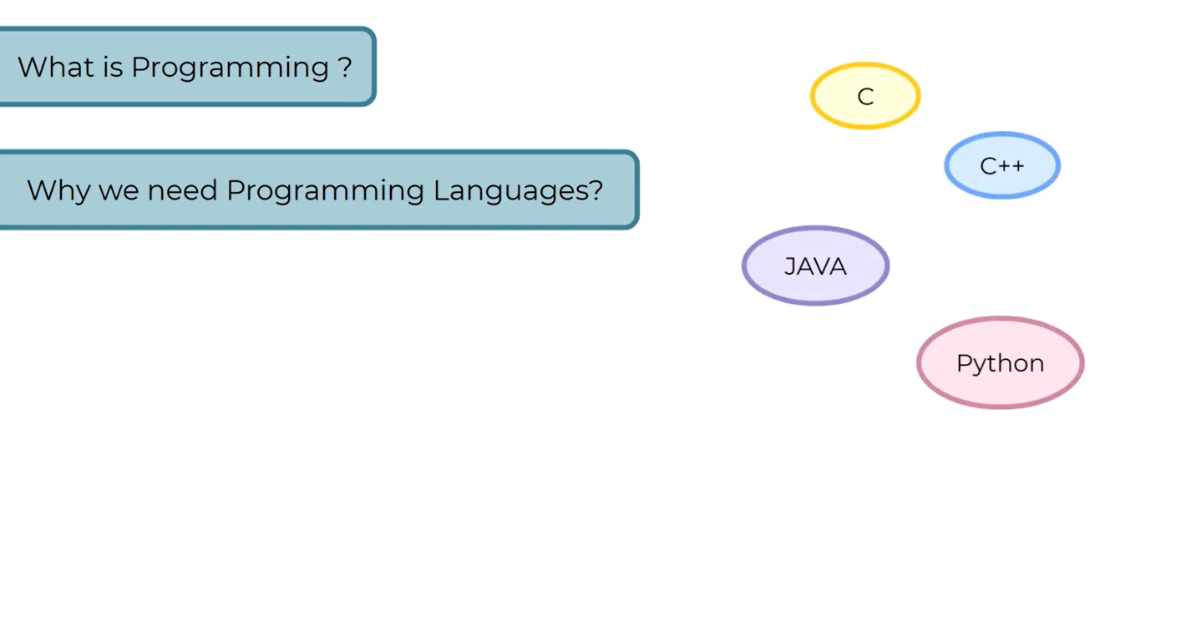

Slide 3
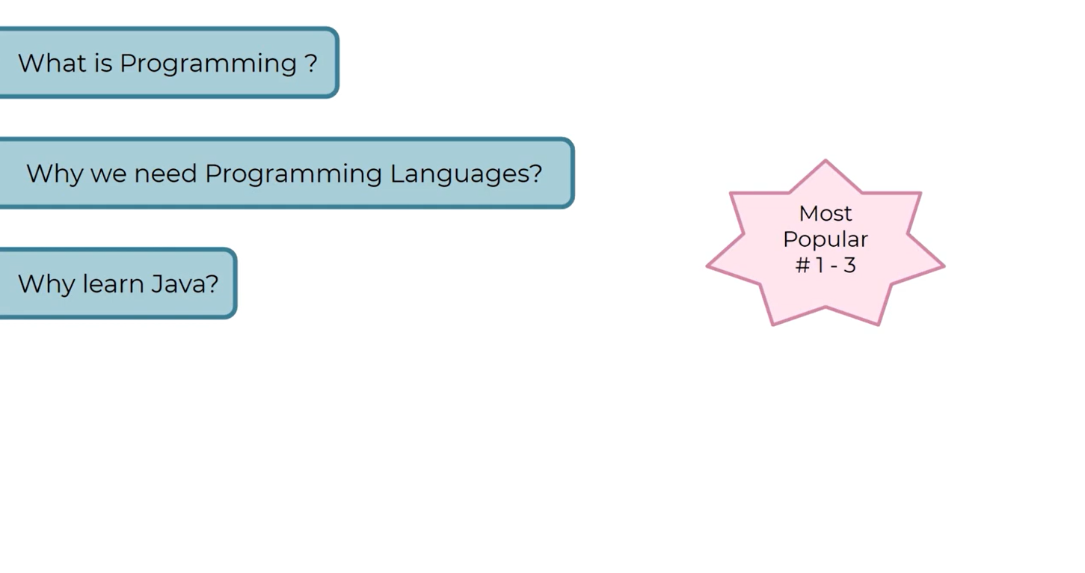

Slide 4
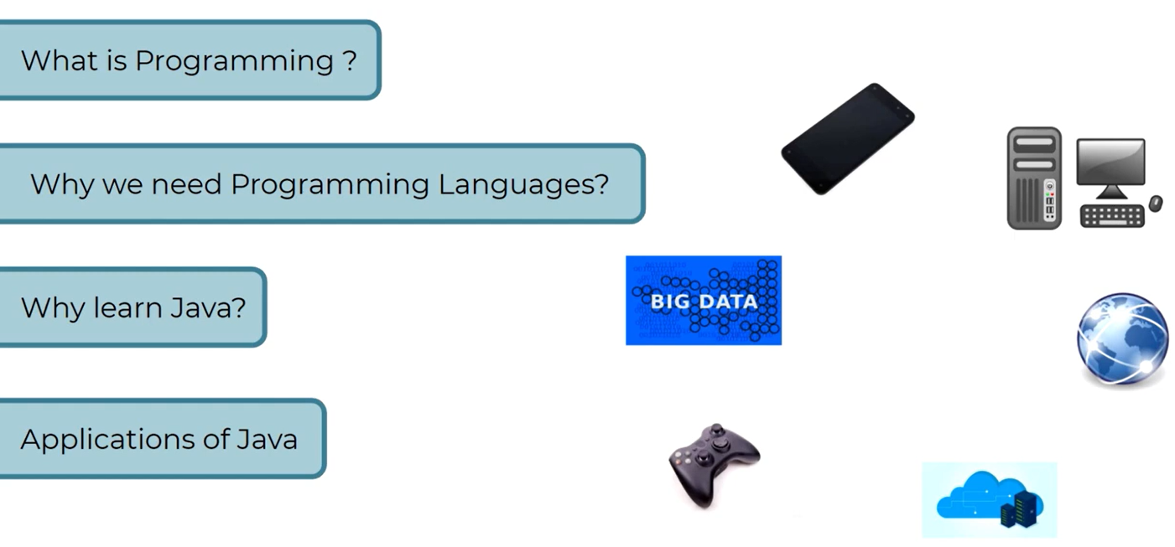

Slide 5
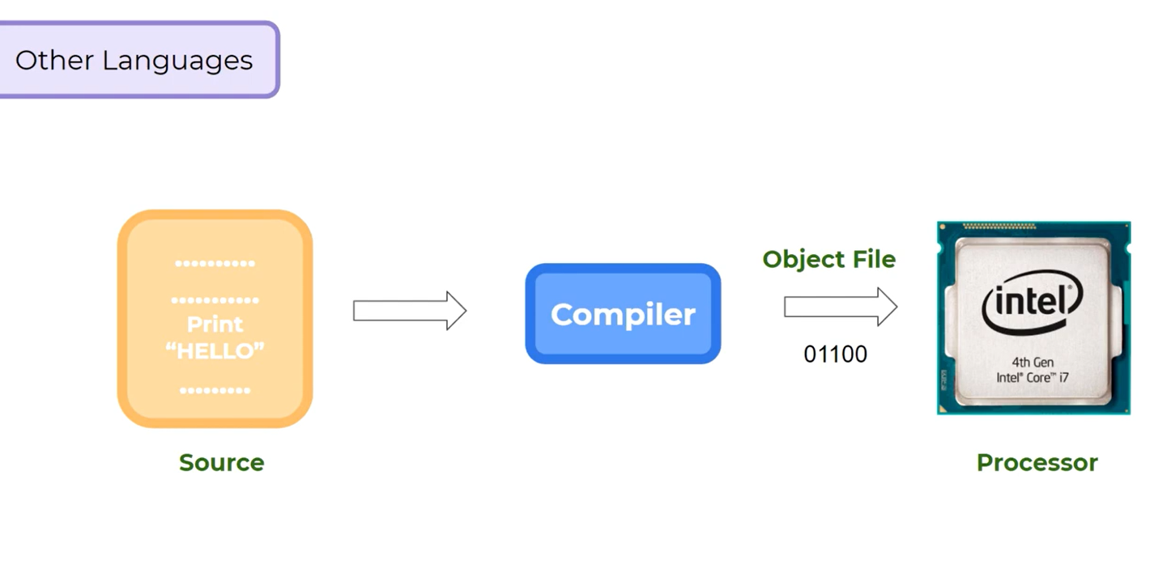

Slide 6
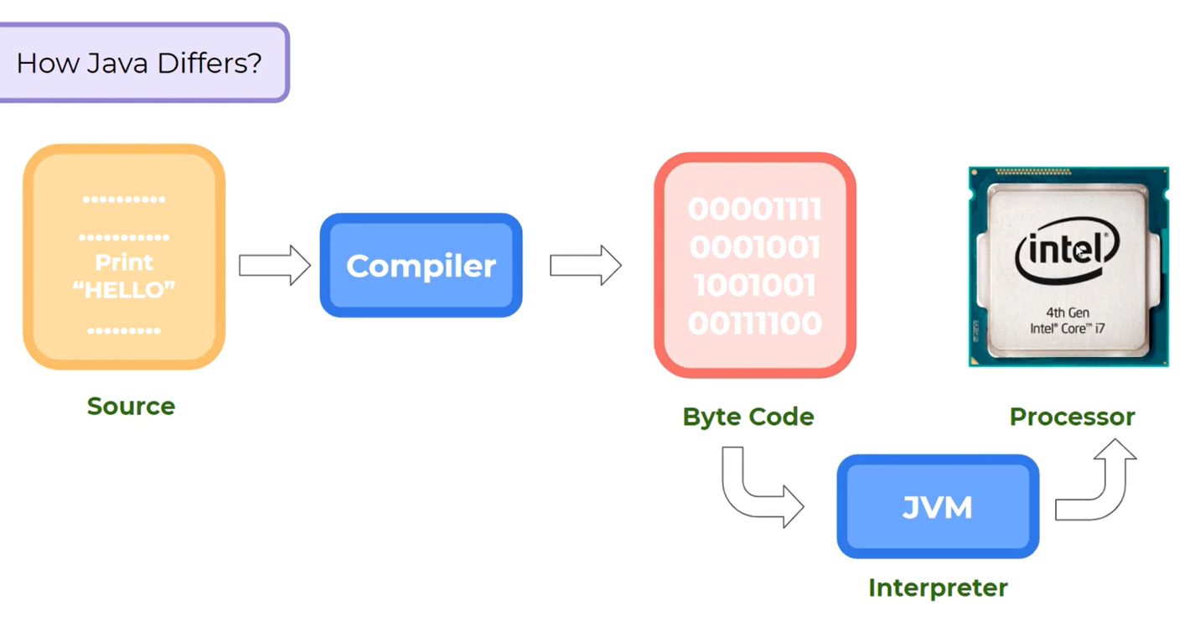

Slide 7


Slide 8
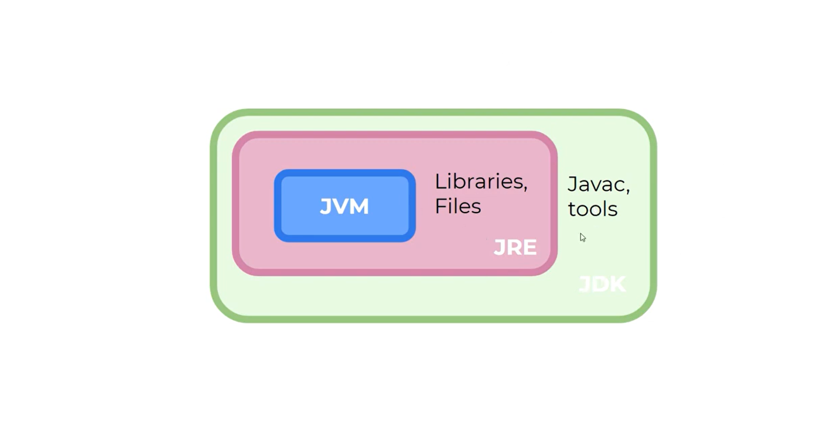

Slide 9


Slide 10
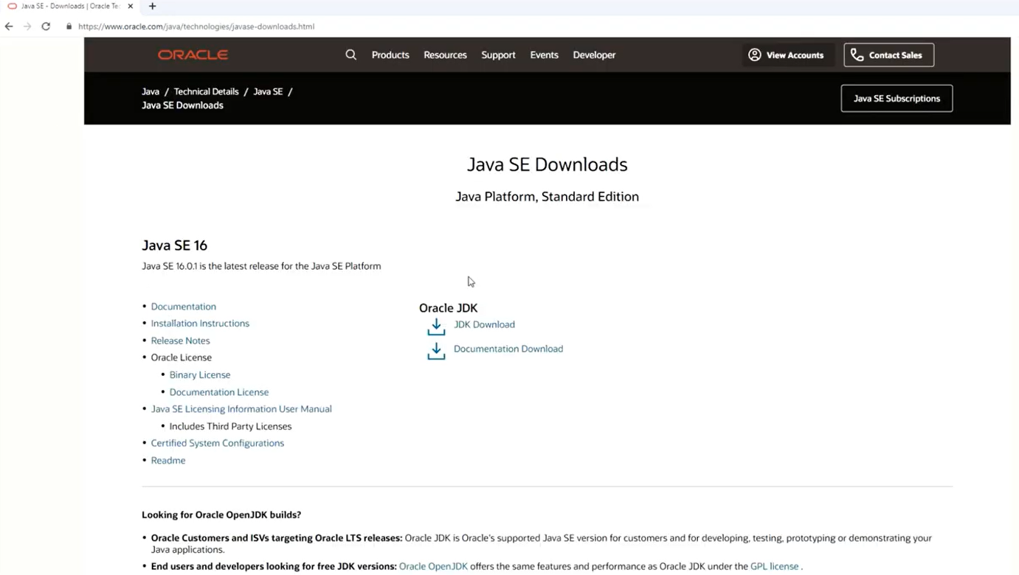

Slide 11
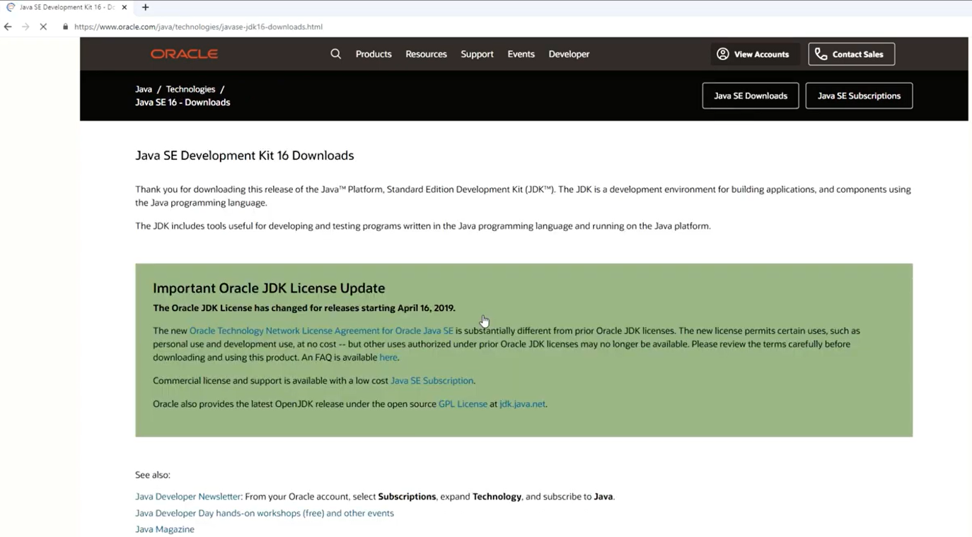

Slide 12
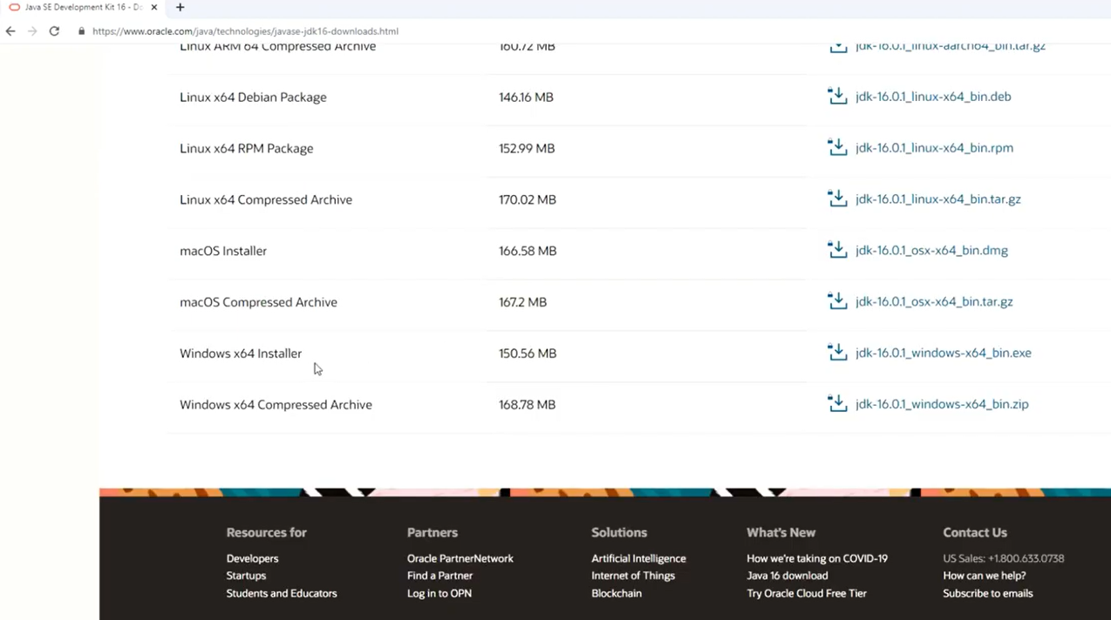

Slide 13
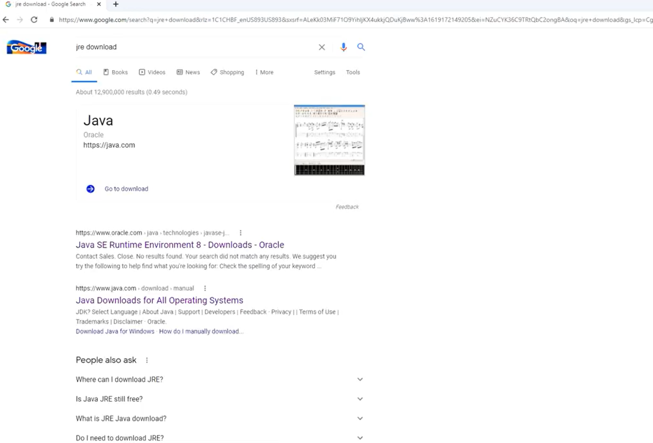

Slide 14
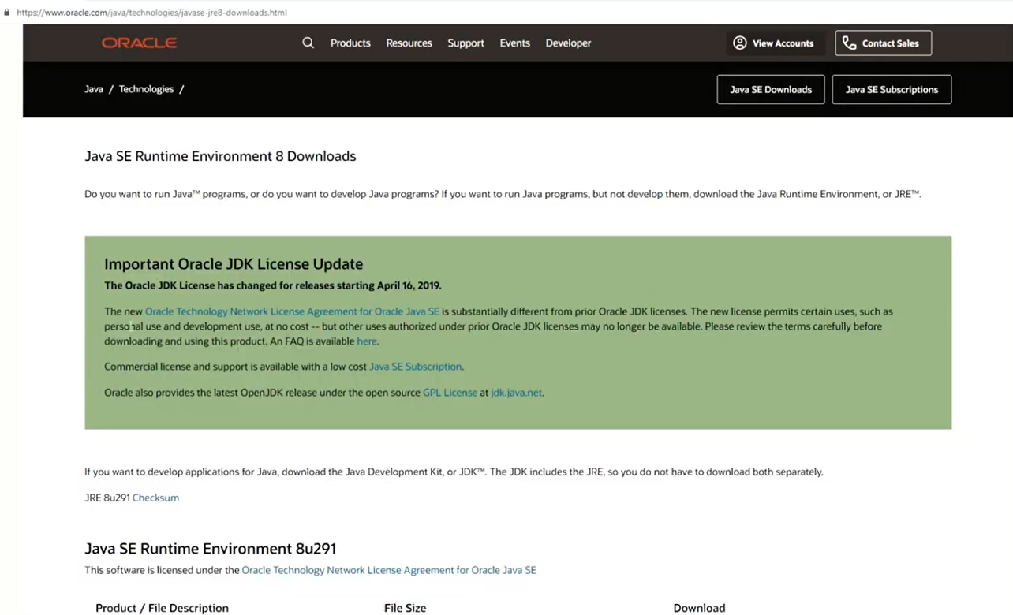

Slide 15
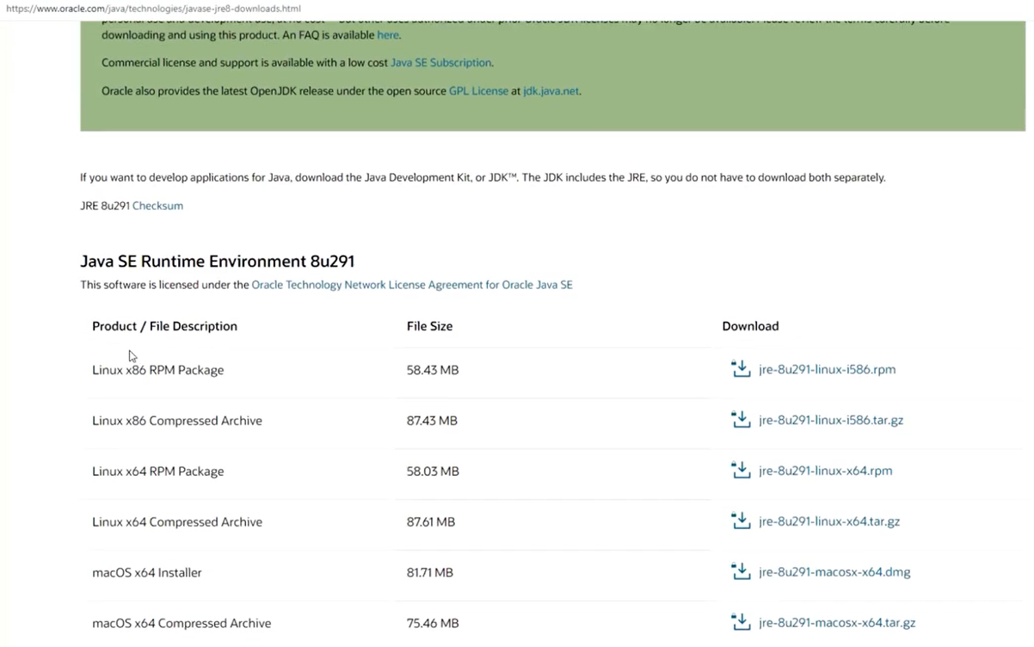

Slide 16
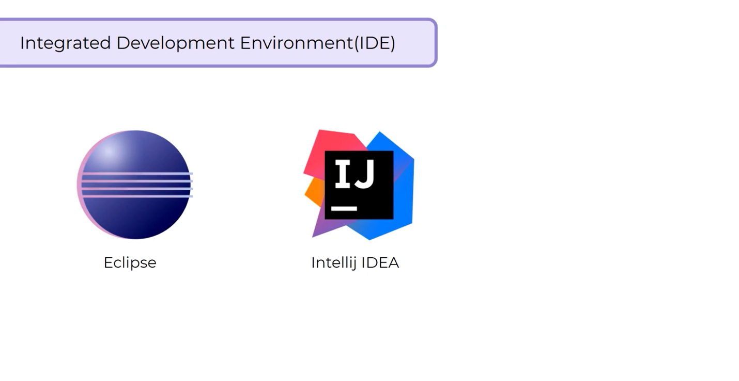

Slide 17
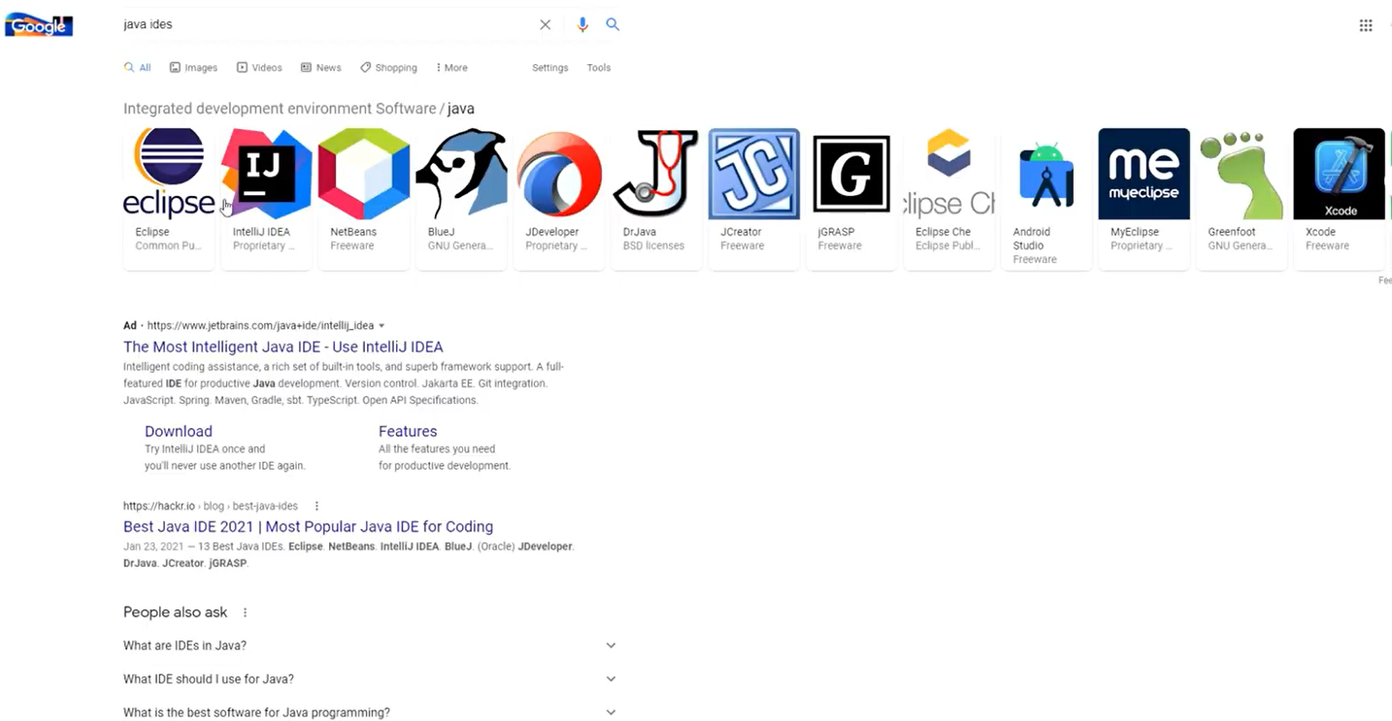

Slide 18
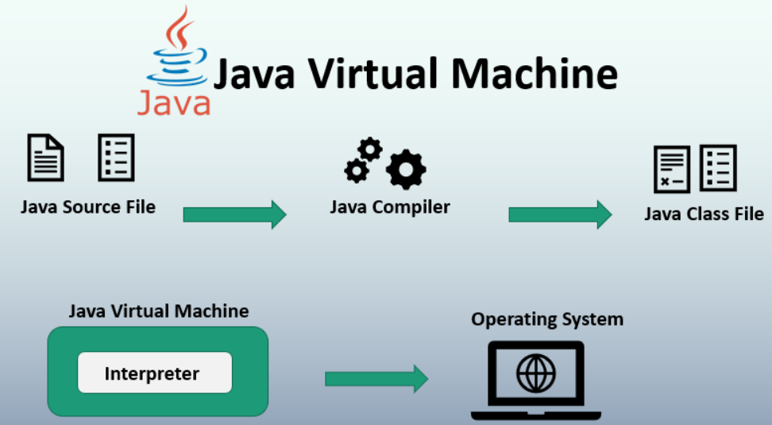

Slide 19
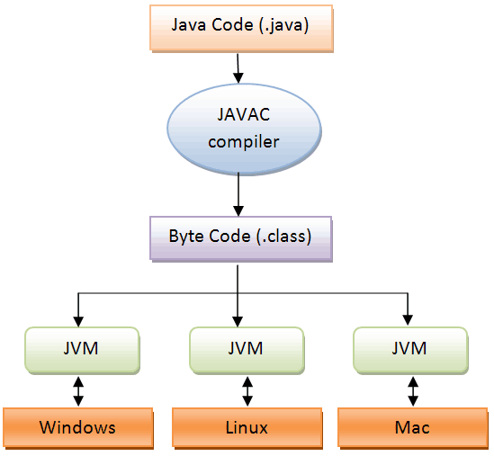

Slide 20
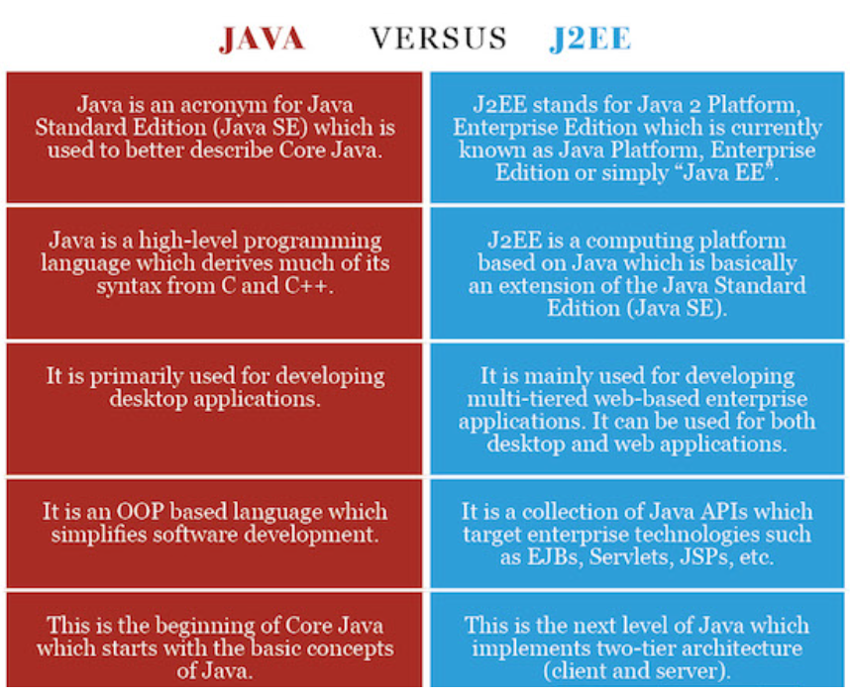

Slide 21
Features of Java/Java Buzzwords
The primary objective of Java programming language creation was to make it portable, simple and secure programming language. Apart from this, there are also some excellent features which play an important role in the popularity of this language. The features of Java are also known as Java buzzwords.
A list of the most important features of the Java language is given below.
Simple
Object-Oriented
Portable
Platform independent
Secured
Robust
Architecture neutral
Interpreted
High Performance
Multithreaded
Distributed
Dynamic

Slide 22
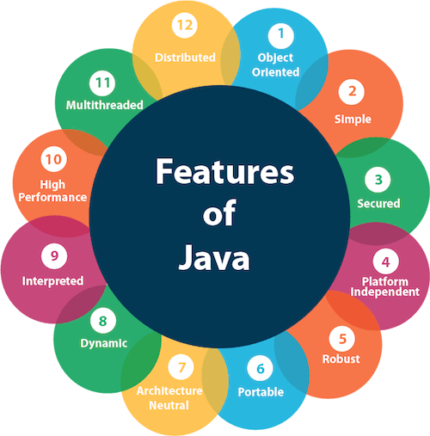
Features of Java/Java Buzzwords

Slide 23
Java Applet
Applet is a special type of program that is embedded in the webpage to generate the dynamic content. It runs inside the browser and works at client side.
Advantage of Applet
There are many advantages of applet. They are as follows:
It works at client side so less response time.
Secured
It can be executed by browsers running under many plateforms, including Linux, Windows, Mac Os etc.
Drawback of Applet
Plugin is required at client browser to execute applet.

Slide 24
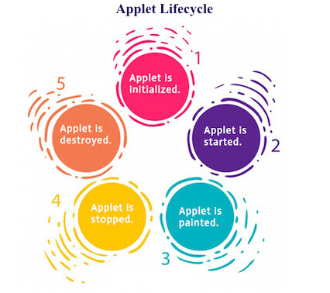
Lifecycle of Java Applet
Applet is initialized.
Applet is started.
Applet is painted.
Applet is stopped.
Applet is destroyed.
Lifecycle of Java Applet
Applet is initialized
Applet is started
Applet is painted
Applet is stopped
Applet is destroyed

Slide 25
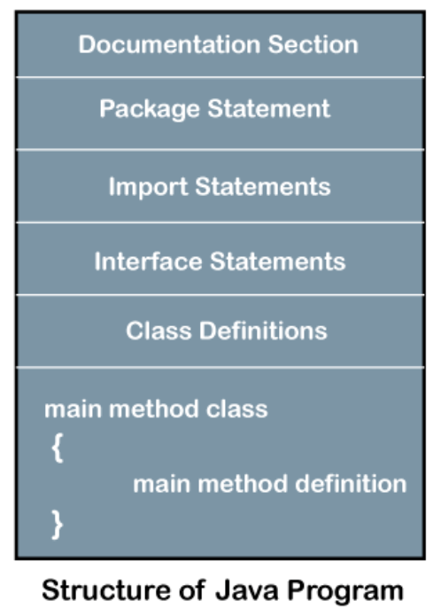
Structure of Java Program

Slide 26
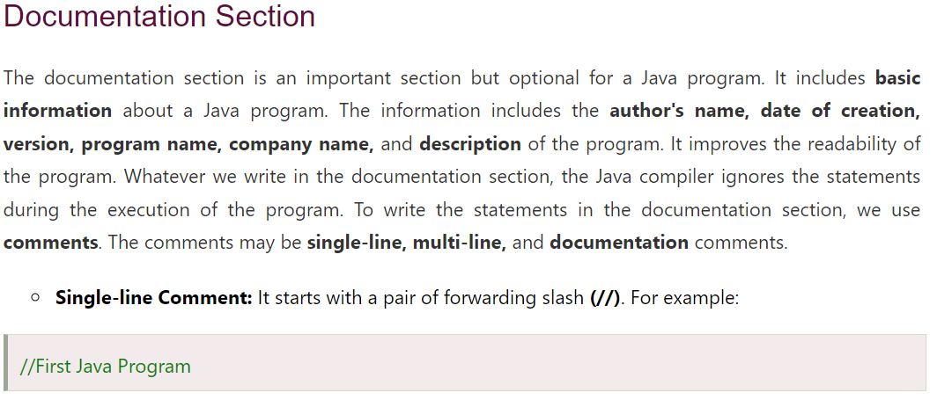
Structure of Java Program

Slide 27
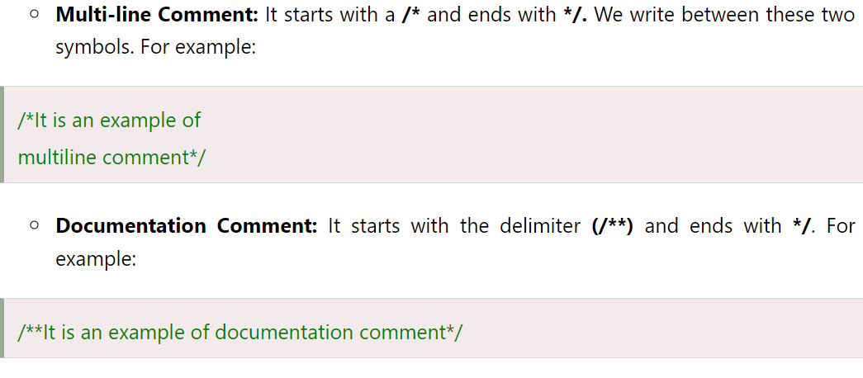
Structure of Java Program

Slide 28
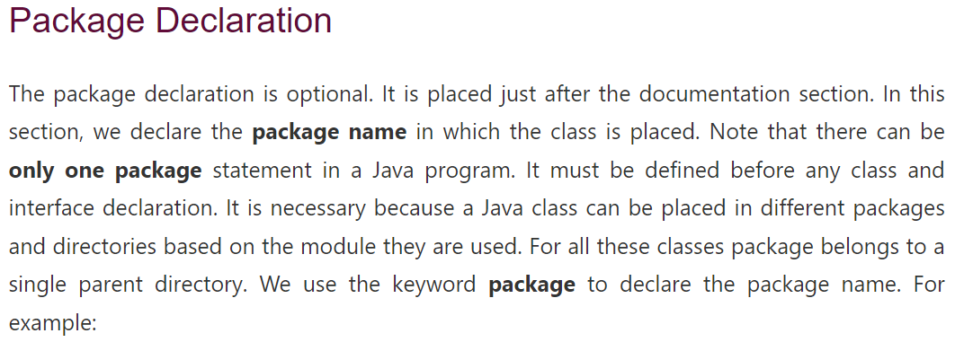

Structure of Java Program

Slide 29
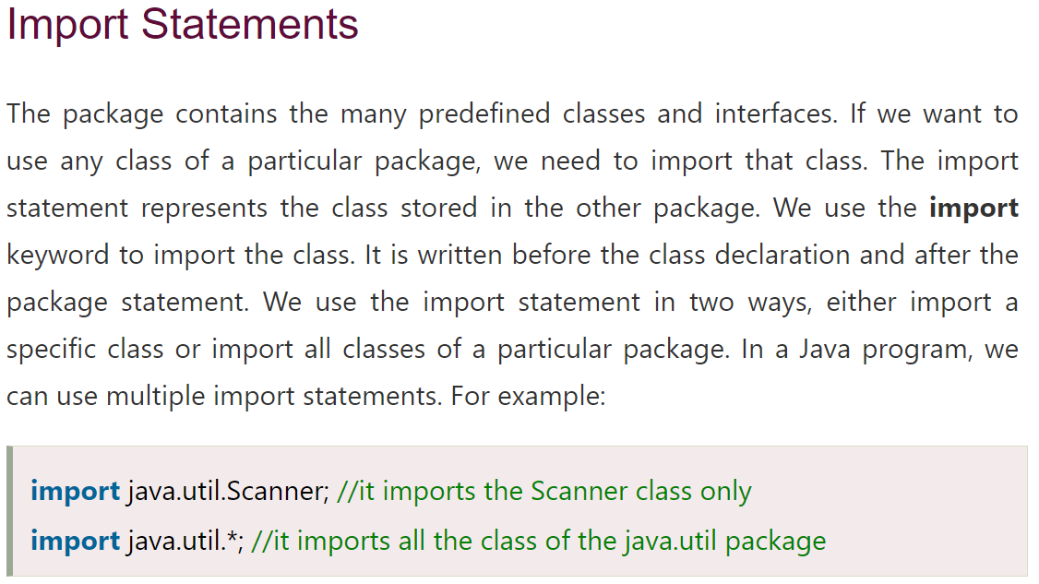
Structure of Java Program

Slide 30
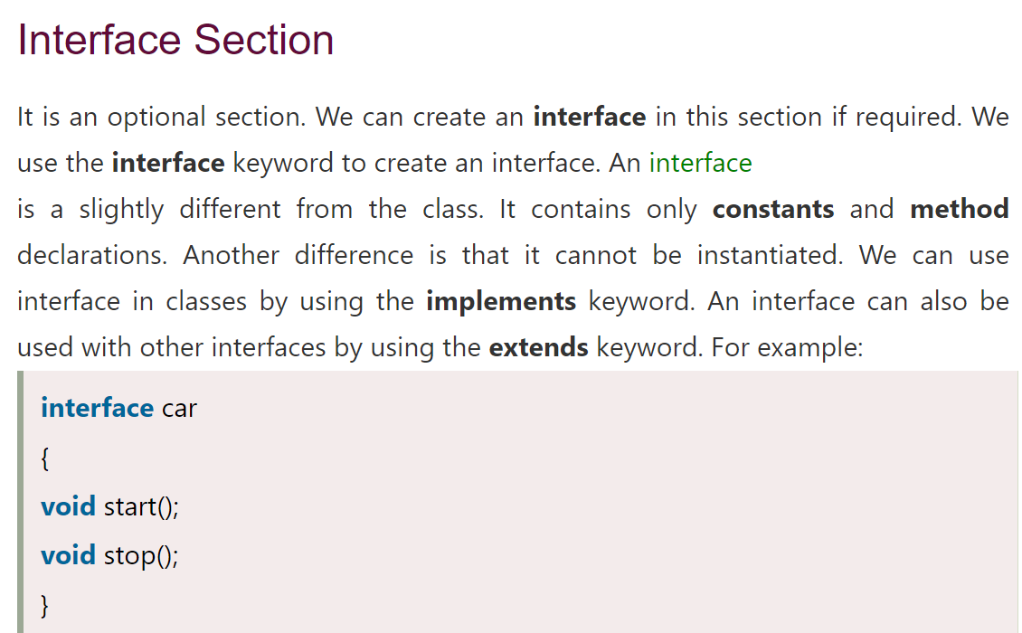
Structure of Java Program

Slide 31
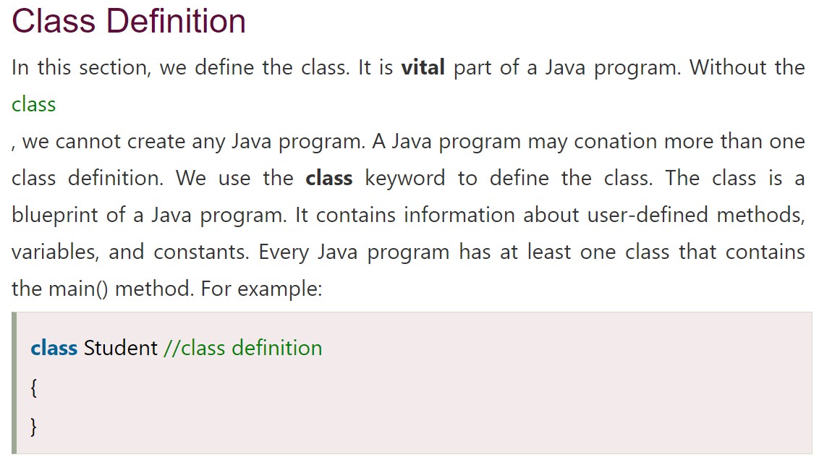
Structure of Java Program

Slide 32
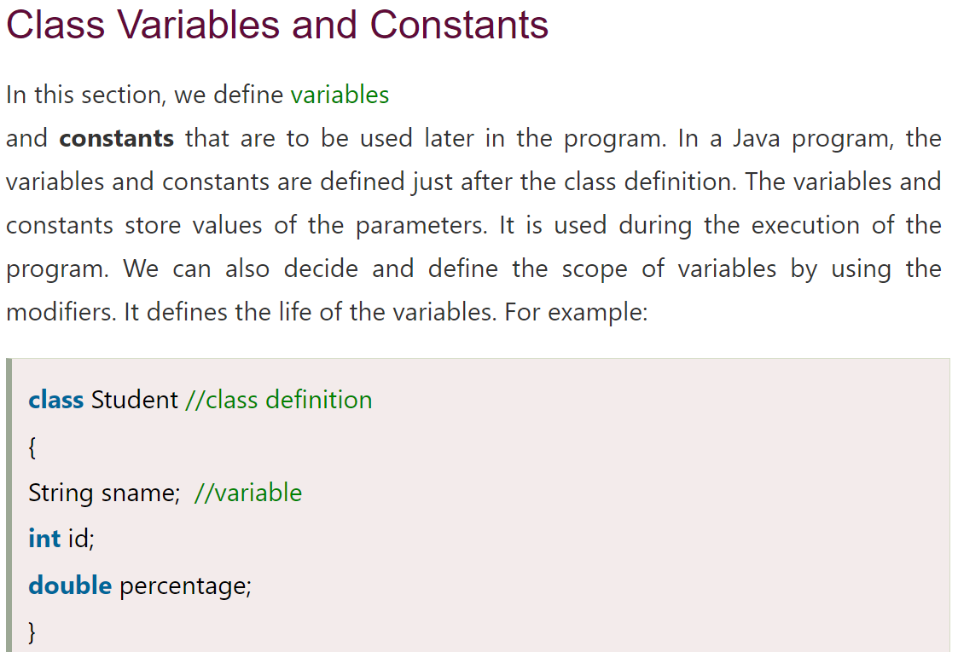
Structure of Java Program

Slide 33
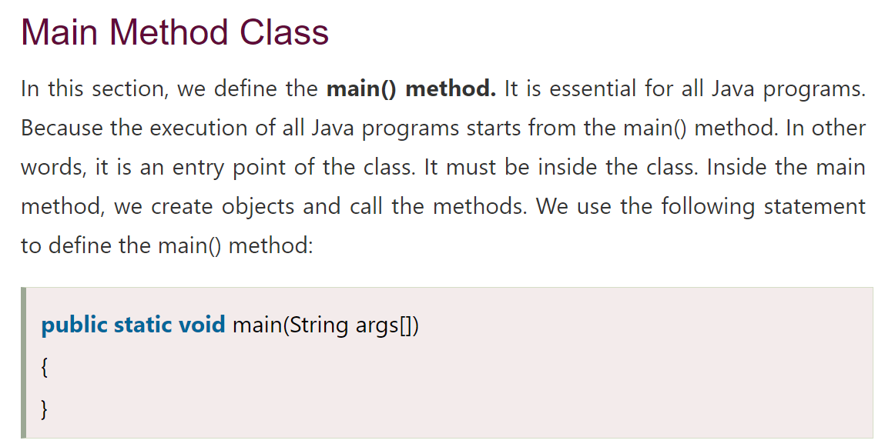
Structure of Java Program

Slide 34
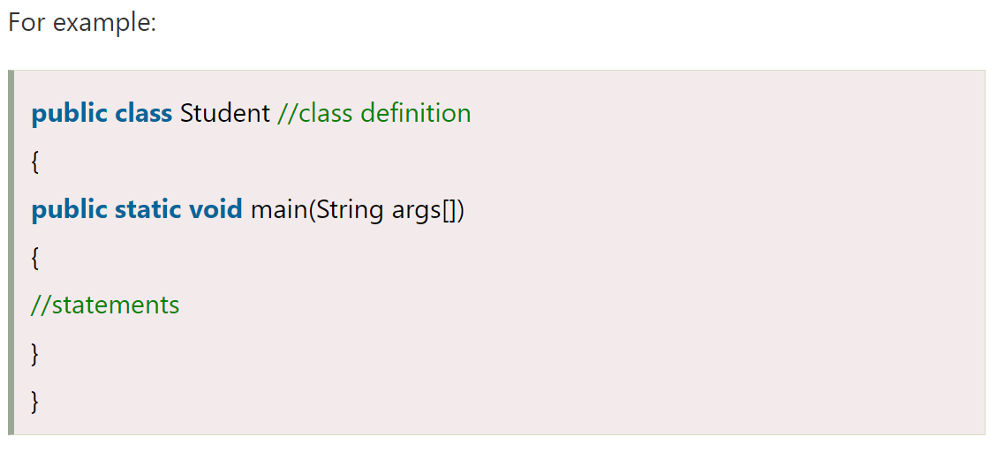
Structure of Java Program

Slide 35
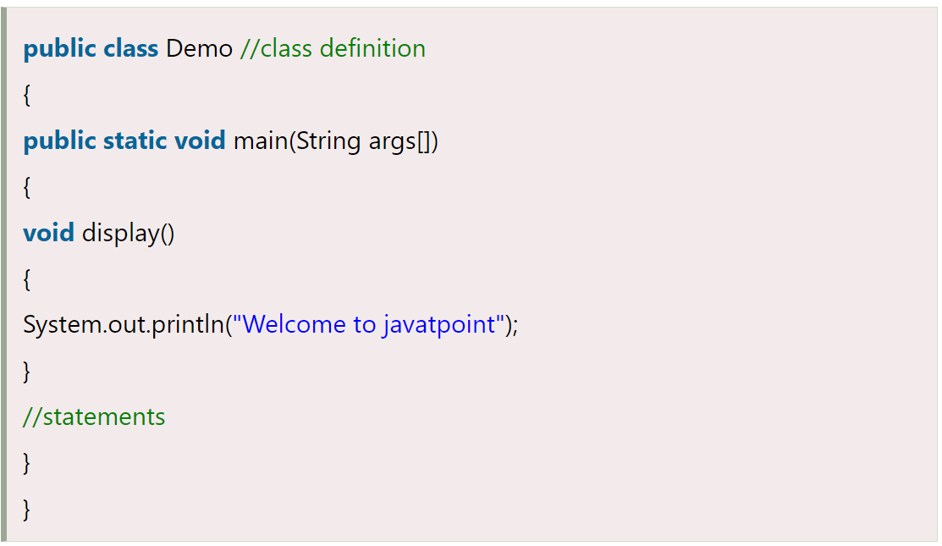
Structure of Java Program

